Slide 1

Machine Learning
Chris Piech
CS106A, Stanford University

Slide 2



Slide 3
Architecture
Simulator
Has a tank
FishTank
Has many fish
Fish
Fish
Fish
Has an img
Has a goal
img
goal
img
goal
img
goal

Slide 4
Architecture
Simulator
Has a tank
The job of a fish is to update its image and goal each heartbeat
FishTank
Has many fish
Fish
Fish
Fish
Has an img
Has a goal
img
goal
img
goal
img
goal

Slide 5
Architecture
Simulator
Has a tank
The job of a fish tank is to keep track of all the fish and to tell them to update each heartbeat
FishTank
Has many fish
Fish
Fish
Fish
Has an img
Has a goal
img
goal
img
goal
img
goal

Slide 6
Architecture
Simulator
Has a tank
The job of the simulator is to “control” the program. Handle user events, run animation.
FishTank
Has many fish
Fish
Fish
Fish
Has an img
Has a goal
img
goal
img
goal
img
goal

Slide 7
Whose job is it to put the imges on the screen?

Slide 8
Architecture
Simulator
Has a tank
FishTank
Has many fish
Fish
Fish
Fish
Has an img
Has a goal
img
goal
img
goal
img
goal

Slide 9
Architecture
Simulator
Has a tank
The job of a fish tank is to manage the display and state.
FishTank
Has many fish
Fish
Fish
Fish
Has an img
Has a goal
img
goal
img
goal
img
goal

Slide 10
extends
Make a class inherit all the
instance variables and methods
of another class

Slide 11
public class Simulator extends GraphicsProgram {
// class definition
}

Slide 12
public class NameSurferGraph extends GCanvas {
// class definition
}

Slide 13
public class FishTank extends GCanvas {
// class definition
}

Slide 14
Architecture
Simulator
Has a tank
Is a GCanvas
FishTank extends GCanvas
Has many fish
Fish
Fish
Fish
Has an img
Has a goal
img
goal
img
goal
img
goal

Slide 16
implements
I promise that this class will define
a few given methods

Slide 17
public class NameSurferGraph extends GCanvas,
implements ComponentListener {
// class definition
}

Slide 18
Also a cheeky way to share constants between classes
implements
I promise that this class will define
a few given methods

Slide 19


Four Prototypical Trajectories
Machine Learning

Slide 20
Four Prototypical Trajectories
Machine Learning
or, How we learned to decompose

Slide 21
Four Prototypical Trajectories
There is something going on
in the world of AI

Slide 22
Four Prototypical Trajectories
Something big (for us)…

Slide 23
Four Prototypical Trajectories
[suspense]

Slide 24
How can we develop intelligent agents?

Slide 25

Volunteer

Slide 26
Computer
programs
How can we develop intelligent agents?
Better than
chance
As well as
humans

Slide 27
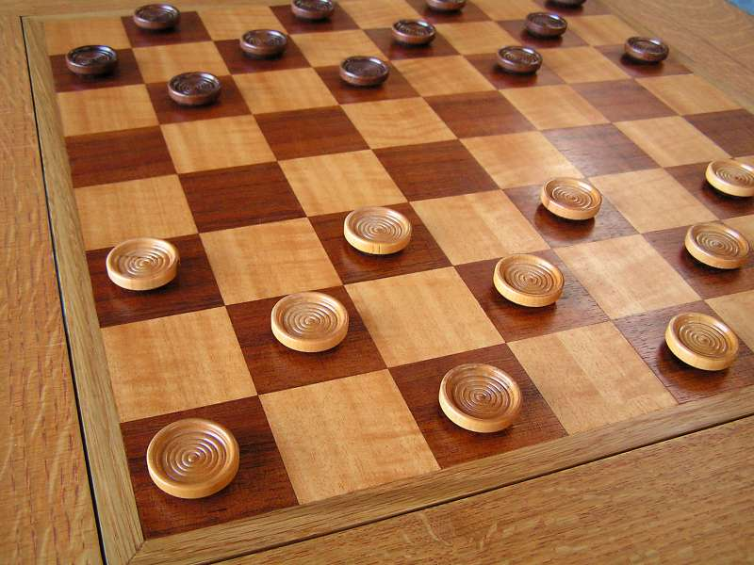
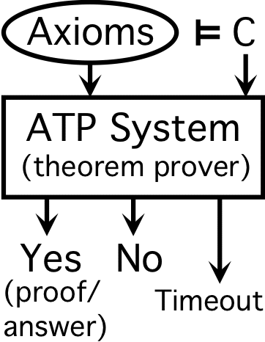
Early Optimism 1950
1952
1955

Slide 28
Early Optimism 1950
“Machines will be capable, within twenty years, of doing any work a man can do.”
–Herbert Simon, 1952

Slide 29
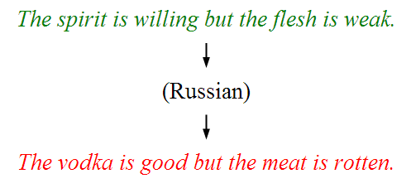
Underwhelming Results 1950s to 1980s
The world is too complex

Slide 30


Slide 31
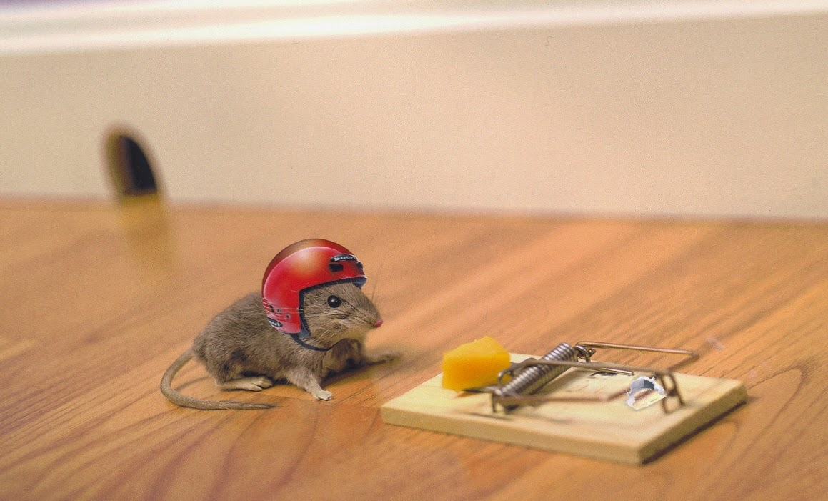
Machine Learning: Learn From Experience

Slide 32
Four Prototypical Trajectories
Some success

Slide 33
Four Prototypical Trajectories
Hard problems seemed impossible.

Slide 34
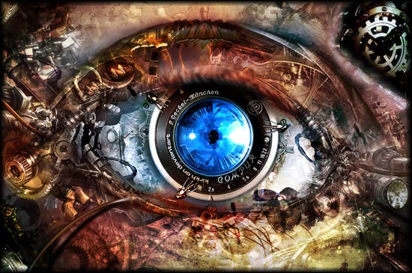


Slide 35

Can we predict hand written digits?

Slide 36


Can we predict birds vs planes?

Slide 37

Vision is Hard

Slide 38

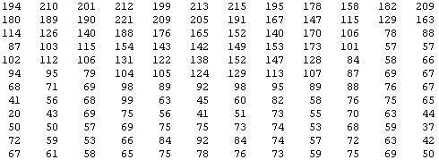
Why is this hard?
Vision is Hard
[
You see this:
But the camera sees this:
[Andrew Ng]

Slide 39
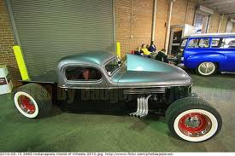
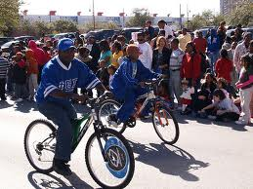
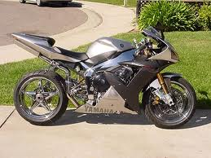

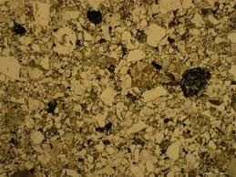

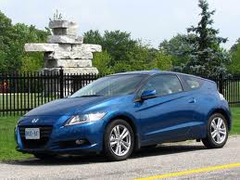
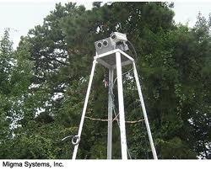
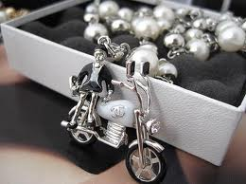
Not Perfect…
Motorcycle
Motorcycle
Motorcycle
Motorcycle
Motorcycle
Motorcycle
Motorcycle
Motorcycle
Motorcycle
Notes:
Good faith effort to implement state-of-the-art.
Cluttered scenes.

Slide 40
Great idea inspired by biology

Slide 41
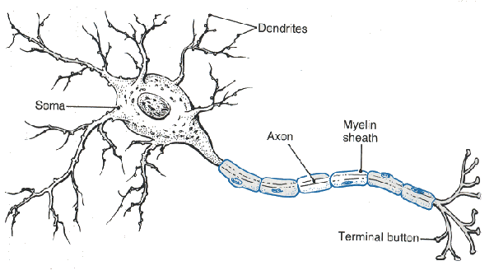
Neuron

Slide 42
Neuron

Slide 43
Neuron

Slide 44
Neuron

Slide 45
Neuron

Slide 46
Some Inputs are More Important

Slide 47
Artificial Neuron
2
3
-2
1

Slide 48
Artificial Neuron
1
2
1
3
6
0.99
-2
0
1
1

Slide 49
Artificial Neuron
1
2
1
3
6
0.99
-2
0
1
1
buildup = input1 * weight1 +
input2 * weight2 +
input3 * weight3 +
input4 * weight4

Slide 50
Artificial Neuron
1
2
1
3
6
0.99
-2
0
1
1
buildup = 1 * 2 +
1 * 3 +
0 * -2 +
1 * 1

Slide 51
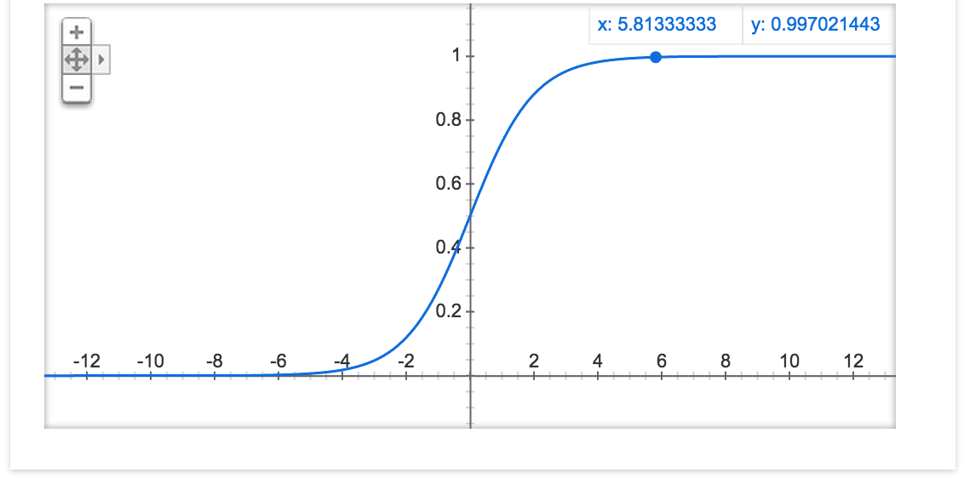
Sigmoid Function
1
2
1
3
6
0.99
-2
0
1
1

Slide 52
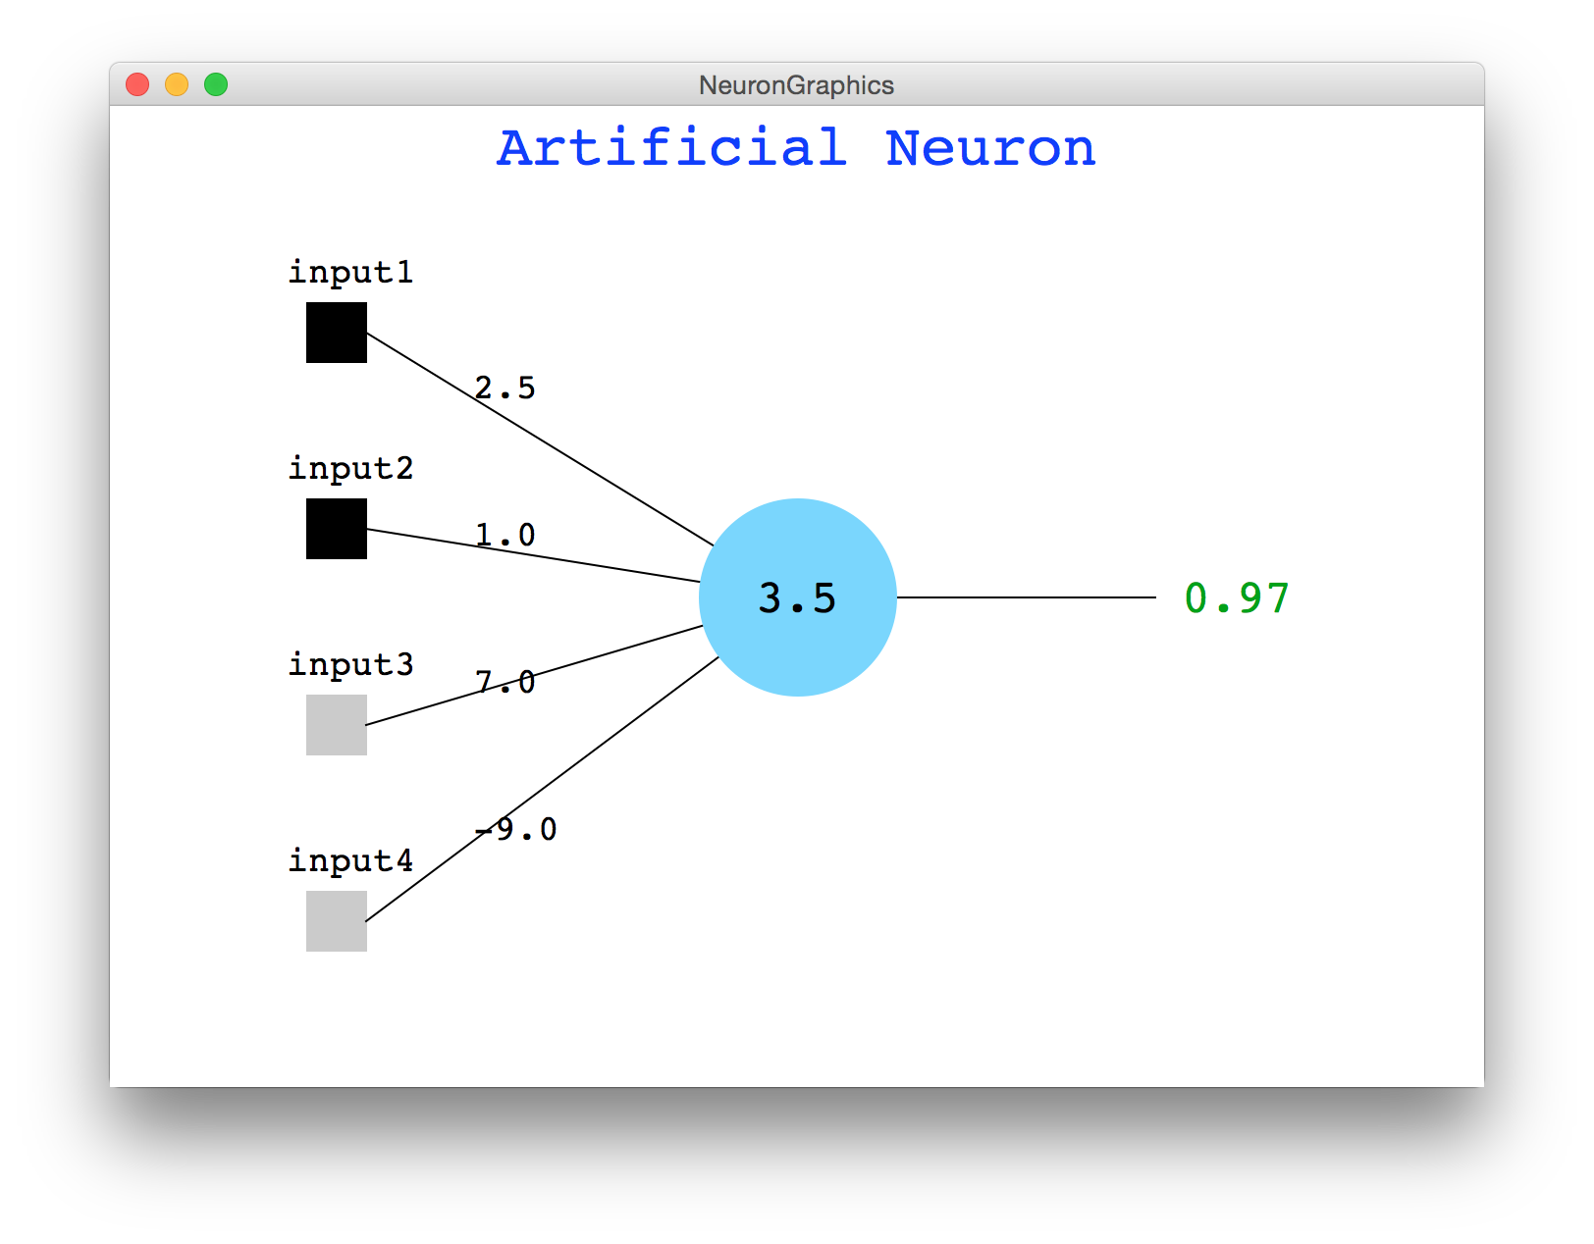
Java Demo

Slide 53


Digit Recognition Example
Let’s make feature vectors from pictures of numbers
input
label
input
label

Slide 54
Single Neuron
This means it predicts a 0
…

Slide 55
Single Neuron
Indicates fully connected
This means it predicts a 0
…

Slide 56
Single Neuron
This means it predicts a 1
…

Slide 57

Not So Good
This means it predicts a 1
…

Slide 58
Logistic Regression and Neural Networks
Single Neuron:
Neural network
x₀
𝜃₁
x₂
𝜃₂
x₃
𝜃₃
x₄
𝜃₄
x₁
x₂
x₃
x₄

Slide 59
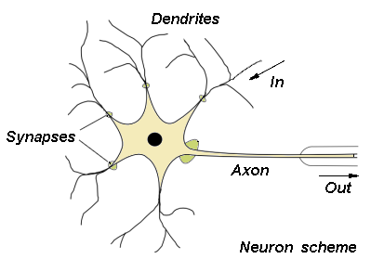
Biological Basis for Neural Networks
A neuron Artificial Neuron
Your brain Neural Network
Actually, it’s probably someone else’s brain
x₀
𝜃₁
x₂
𝜃₂
x₃
𝜃₃
x₄
𝜃₄
x₁
x₂
x₃
x₄

Slide 60
We Can Put Neurons Together
This means it predicts a 0
…

Slide 61
We Can Put Neurons Together
There is an adjustable parameter for every connection
This means it predicts a 0
…
Look at a single “hidden” neuron

Slide 62
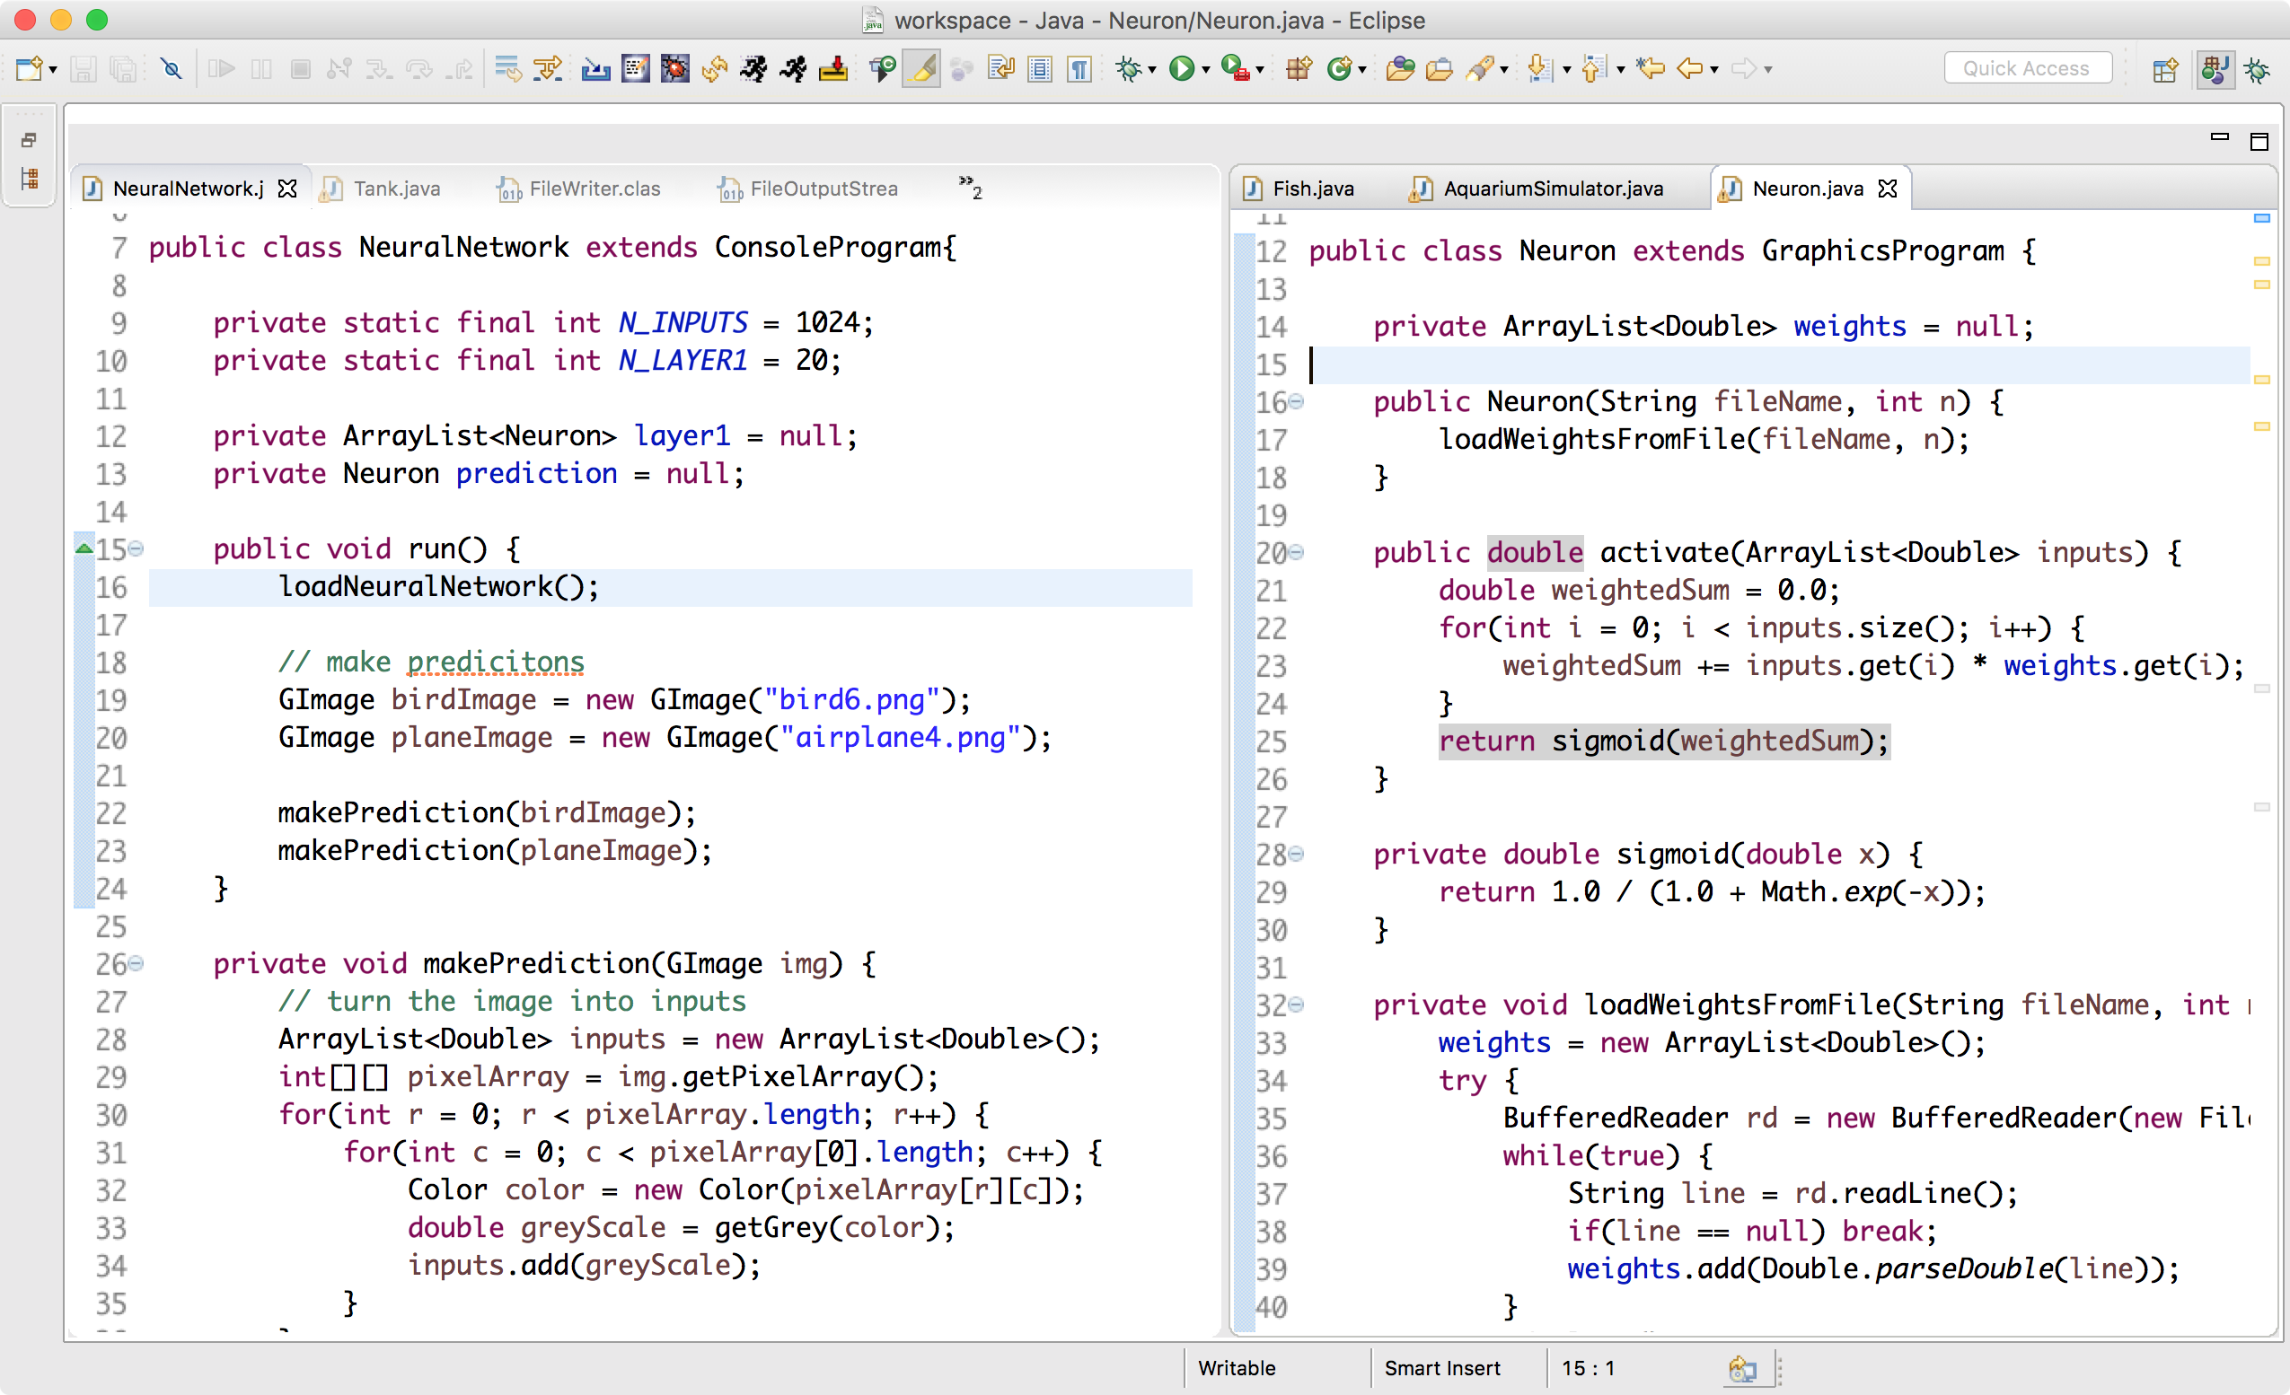
What Does This Look Like in Code?

Slide 63
Aside: decomposition

Slide 64
How do we get those weights?

Slide 65
Neural Network
Each node represents a neuron (or a vector of neurons)
Each edge represents the weight of the interaction

Slide 66
Forward Pass…

Slide 67
Forward Pass
Each node represents a neuron (or a vector of neurons)
Each edge represents the weight of the interaction

Slide 68
Forward Pass
Each node represents a neuron (or a vector of neurons)
Each edge represents the weight of the interaction

Slide 69
Forward Pass
Each node represents a neuron (or a vector of neurons)
Each edge represents the weight of the interaction

Slide 70
Forward Pass
Each node represents a neuron (or a vector of neurons)
Each edge represents the weight of the interaction

Slide 71
Backward Pass…

Slide 72
Backward Pass
The image had a 0 but we predicted a 1

Slide 73
Backward Pass
The image had a 0 but we predicted a 1
We start by making our missprediction a numerical “loss”

Slide 74
Backward Pass
The image had a 0 but we predicted a 1
We start by making our missprediction a numerical “loss”
For each edge weight we calculate

Slide 75
Gradient of output layer params
That looks scarier than it is

Slide 76
Chain Rule Down the Network

Slide 77
Artificial Neurons: One of the greatest decompositions of our lifetimes

Slide 78
model.calculatePartialDerivative(data)

Slide 79
model.update(data)

Slide 80
Works for any number of layers
Weight between two neurons

Slide 81
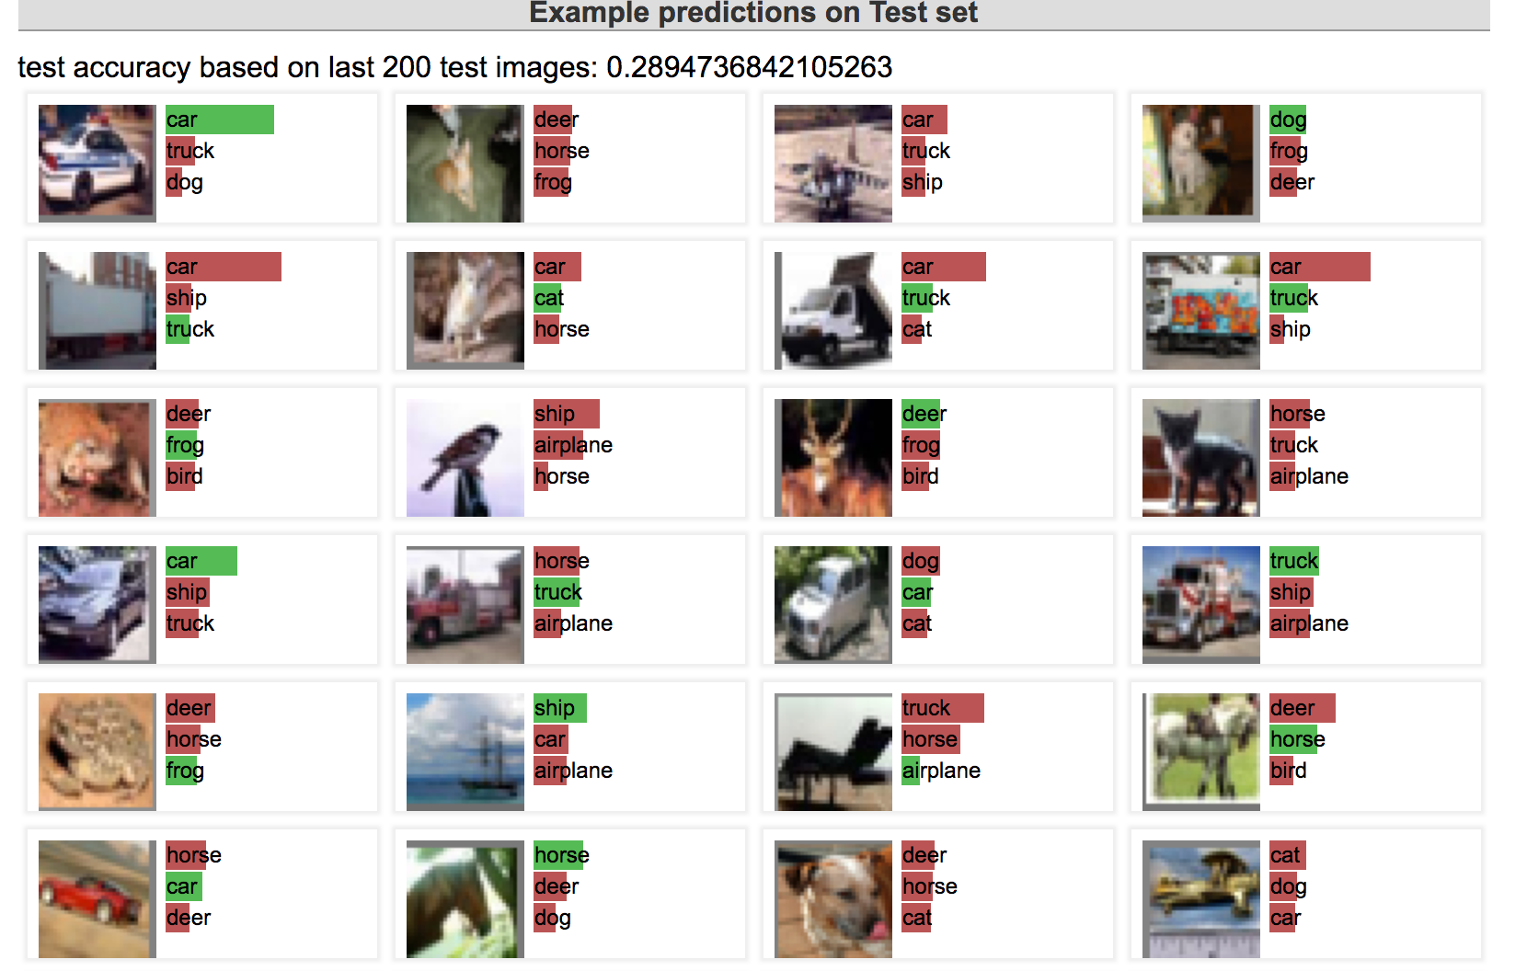
Let’s Train!
http://cs.stanford.edu/people/karpathy/convnetjs/demo/classify2d.html

Slide 82
Like lego pieces

Slide 83

GoogLeNet Brain
1 Trillion Artificial Neurons

Slide 84
GoogLeNet Brain Graph
Multiple,
Multi class output
22 layers deep

Slide 85
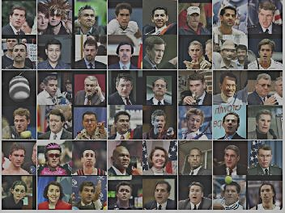
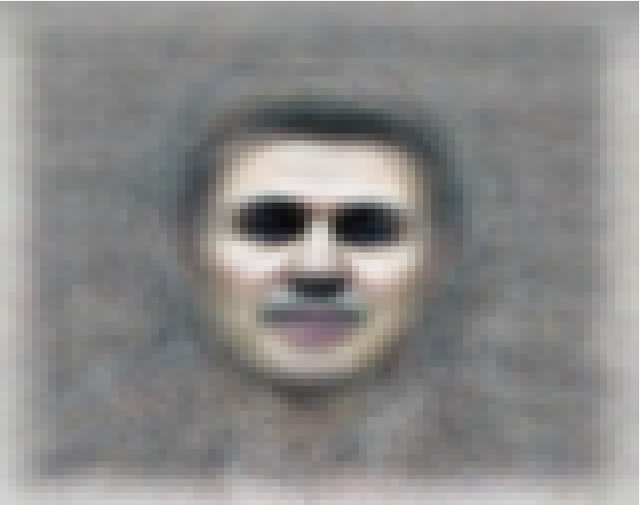
The Face Neuron
Top stimuli from the test set
Optimal stimulus
by numerical optimization
Le, et al., Building high-level features using large-scale unsupervised learning. ICML 2012

Slide 86
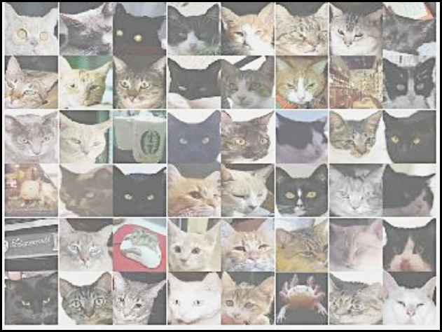
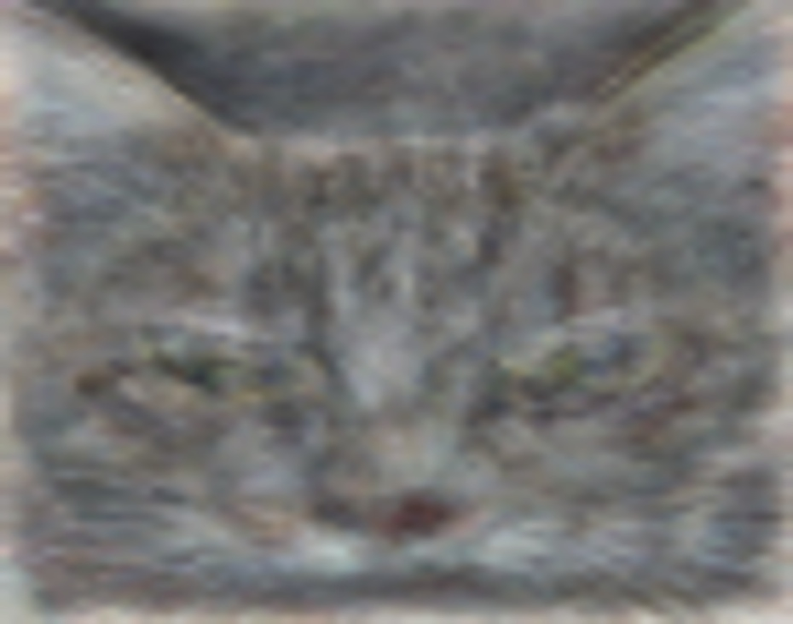
The Cat Neuron
Top stimuli from the test set
Optimal stimulus
by numerical optimization
Le, et al., Building high-level features using large-scale unsupervised learning. ICML 2012

Slide 87
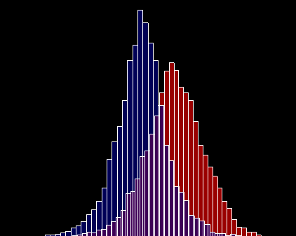
The Cat Neuron
Random distractors
Cat faces
Frequency
Feature value
Le, et al., Building high-level features using large-scale unsupervised learning. ICML 2012

Slide 88


Slide 89

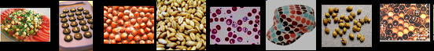



Best Neuron Stimuli
Neuron 1
Neuron 2
Neuron 3
Neuron 4
Neuron 5
Le, et al., Building high-level features using large-scale unsupervised learning. ICML 2012
Input to another layer above
(image with 8 channels)
Number of output
channels = 8
LCN Size = 5
H
Pooling Size = 5
Number
of maps = 8
One layer
W
RF size = 18
Number of input
channels = 3
Image Size = 200

Slide 90




Best Neuron Stimuli
Neuron 6
Neuron 7
Neuron 8
Neuron 9
Le, et al., Building high-level features using large-scale unsupervised learning. ICML 2012
Input to another layer above
(image with 8 channels)
Number of output
channels = 8
LCN Size = 5
H
Pooling Size = 5
Number
of maps = 8
One layer
W
RF size = 18
Number of input
channels = 3
Image Size = 200

Slide 91
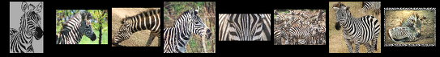




Best Neuron Stimuli
Neuron 10
Neuron 11
Neuron 12
Neuron 13
Le, et al., Building high-level features using large-scale unsupervised learning. ICML 2012
Input to another layer above
(image with 8 channels)
Number of output
channels = 8
LCN Size = 5
H
Pooling Size = 5
Number
of maps = 8
One layer
W
RF size = 18
Number of input
channels = 3
Image Size = 200

Slide 92
ImageNet Classification
22,000 categories
14,000,000 images
Hand-engineered features (SIFT, HOG, LBP),
Spatial pyramid, SparseCoding/Compression
Le, et al., Building high-level features using large-scale unsupervised learning. ICML 2012

Slide 93
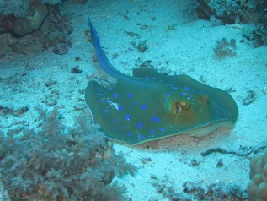
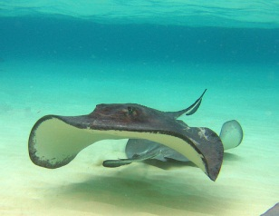
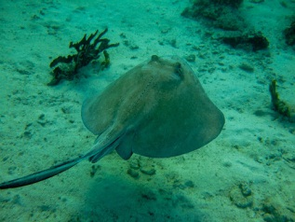
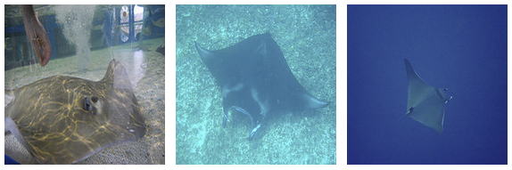
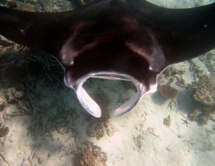
22,000 is a lot!
…
smoothhound, smoothhound shark, Mustelus mustelus
American smooth dogfish, Mustelus canis
Florida smoothhound, Mustelus norrisi
whitetip shark, reef whitetip shark, Triaenodon obseus
Atlantic spiny dogfish, Squalus acanthias
Pacific spiny dogfish, Squalus suckleyi
hammerhead, hammerhead shark
smooth hammerhead, Sphyrna zygaena
smalleye hammerhead, Sphyrna tudes
shovelhead, bonnethead, bonnet shark, Sphyrna tiburo
angel shark, angelfish, Squatina squatina, monkfish
electric ray, crampfish, numbfish, torpedo
smalltooth sawfish, Pristis pectinatus
guitarfish
roughtail stingray, Dasyatis centroura
butterfly ray
eagle ray
spotted eagle ray, spotted ray, Aetobatus narinari
cownose ray, cow-nosed ray, Rhinoptera bonasus
manta, manta ray, devilfish
Atlantic manta, Manta birostris
devil ray, Mobula hypostoma
grey skate, gray skate, Raja batis
little skate, Raja erinacea
…
Stingray
Mantaray

Slide 94
0.005%
1.5%
?
Random guess
Pre Neural Networks
GoogLeNet
Le, et al., Building high-level features using large-scale unsupervised learning. ICML 2012

Slide 95
0.005%
1.5%
43.9%
Random guess
Pre Neural Networks
GoogLeNet
Szegedy et al, Going Deeper With Convolutions, CVPR 2015

Slide 96
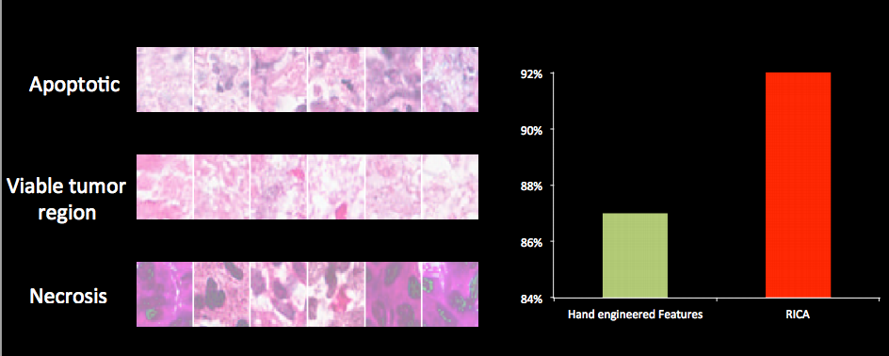
Vision has Social Implications
Neural network

Slide 97
http://sustain.stanford.edu/
http://sustain.stanford.edu/
http://sustain.stanford.edu/

Slide 98
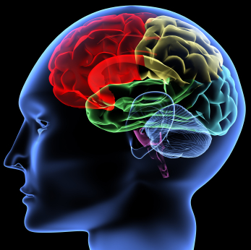
The hypothesis
One Algorithm Hypothesis
Much of perception in the brain can be explained with a single learning algorithm.
[Andrew Ng]

Slide 99

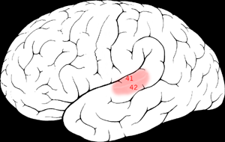

One Learning Algorithm
One Algorithm Hypothesis
Auditory Cortex
Auditory cortex learns to see
[Roe et al., 1992]
[Andrew Ng]

Slide 100
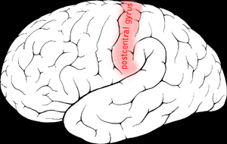

One Algorithm Hypothesis
Somatosensory Cortex
Somatosensory cortex learns to see
[Metin & Frost, 1989]
[Andrew Ng]

Slide 101
Tl;dr our brain is constantly decomposing

Slide 102
Told Vision Was 30 Years Out

Slide 103
Told Speech Was 30 Years Out
Almost perfect…

Slide 104
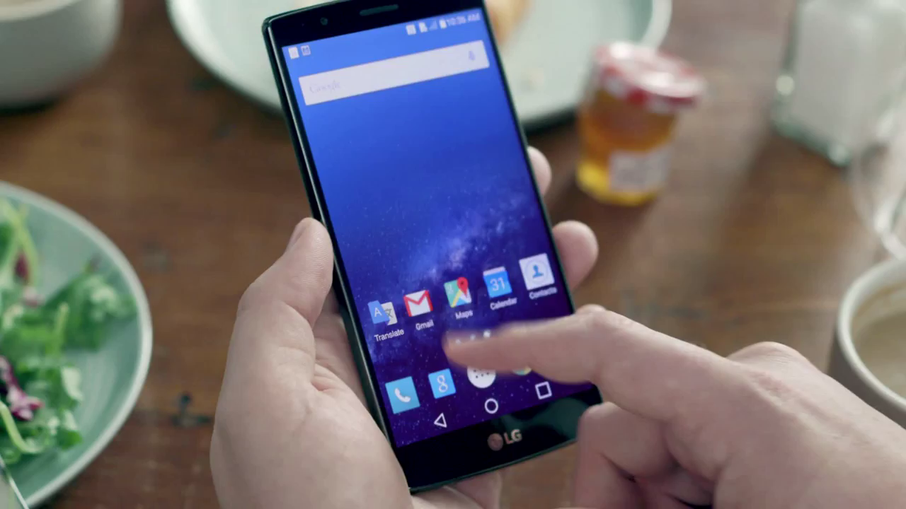
Huge Progress

Slide 105
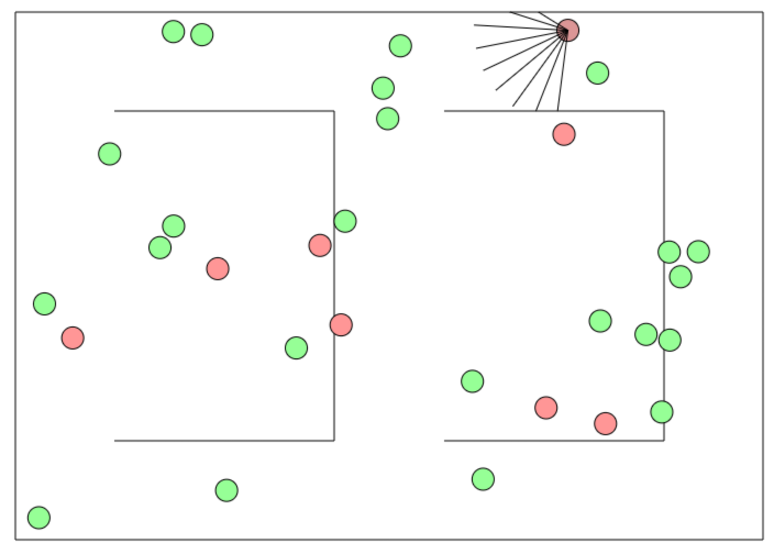
Deep Reinforcement Learning
http://cs.stanford.edu/people/karpathy/convnetjs/demo/rldemo.html

Slide 106
The end

